Slide 1
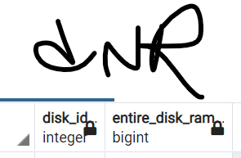
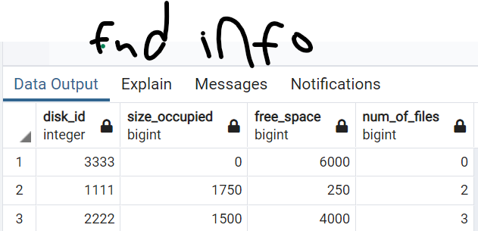
Files
file_id (int) | File_type (TEXT) | size_needed
file_id > 0 |  | size_needed >= 0
All attributes are not optional (not null)
Rams
ram_id (int) | ram_size(int) | company(TEXT)
ram_id > 0 | size> 0
All attributes are not optional (not null)
Disks
disk_id(int) | manufacturing_company(TEXT) | Speed(int) | free_space(int) | cost_per_byte(int)
disk_id > 0 |  | Speed > 0 | free_space >= 0 | Cost_per_byte > 0
All attributes are not optional (not null)
Files_inside_Disks
file_id (int) | disk_id
file_id > 0 | Disk_id> 0
All attributes are not optional (not null)
Rams_inside_Disks
ram_id (int) | disk_id
file_id > 0 | Disk_id> 0
All attributes are not optional (not null)

Slide 2
